Slide 1
Notes for Hindi Urdu and architecture of the grammar

Slide 2
Phonetics/phonology

Slide 3
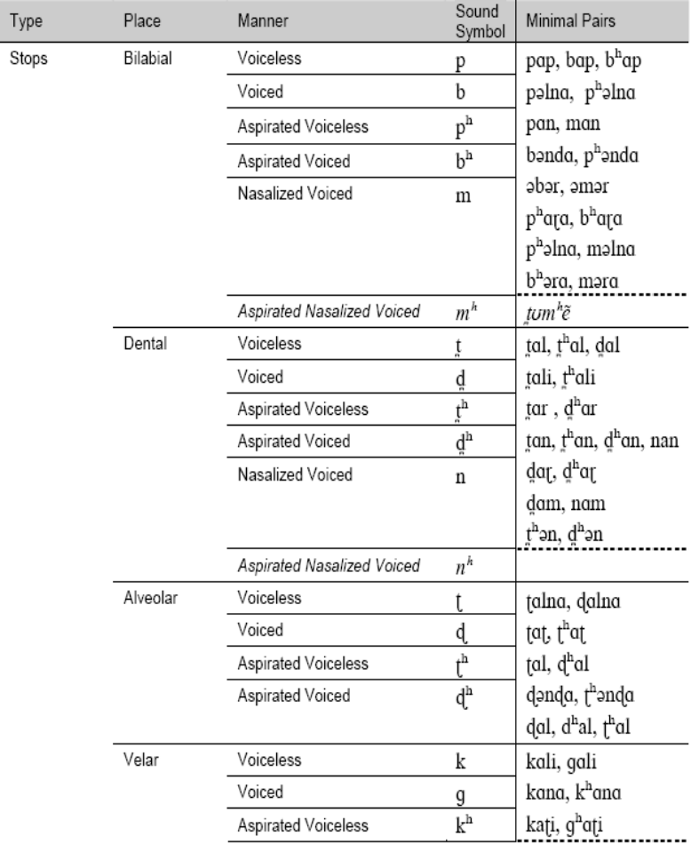
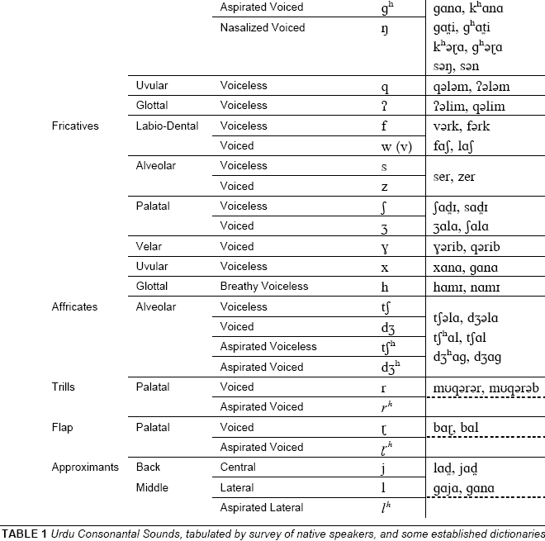
Lahori Consonants crulp-2002-urdu consonantal and vocalic sounds.pdf

Slide 4
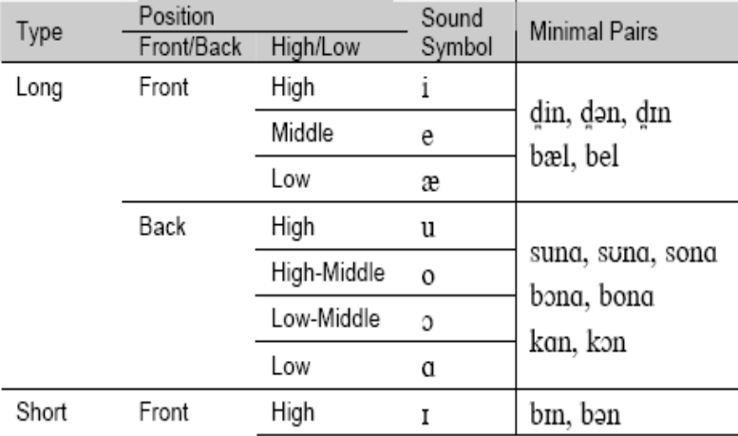
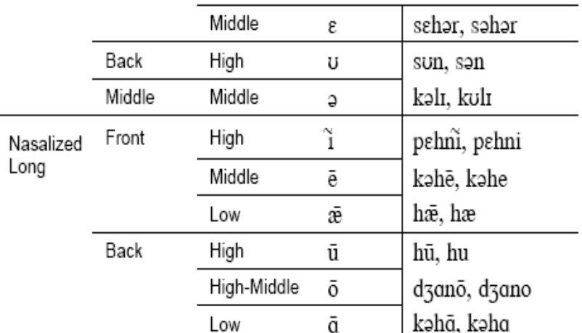
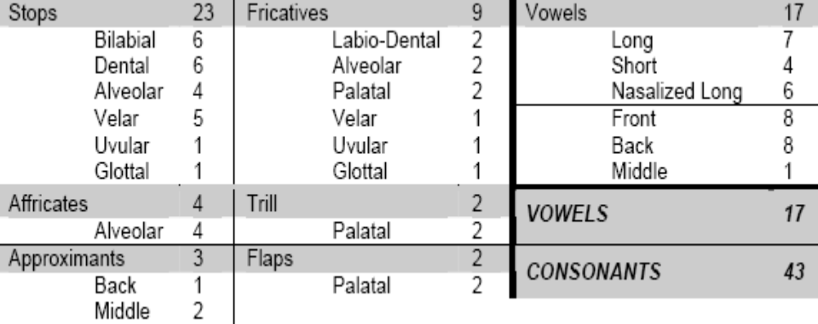
Lahori Vowels crulp-2002-urdu consonantal and vocalic sounds.pdf
  Urdu Consonantal And Vocalic Sounds
  Abdul Mannan Saleem, Hasan Kabir, Muhammad Khurram Riaz, Muhammad Mustafa Rafique, Nauman Khalid, Syed Raza Shahid
  CRULP technical papers 2002

Slide 5
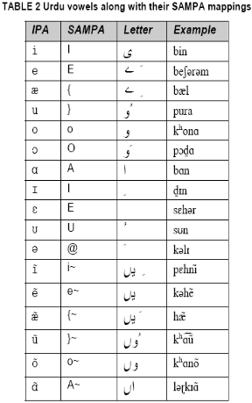
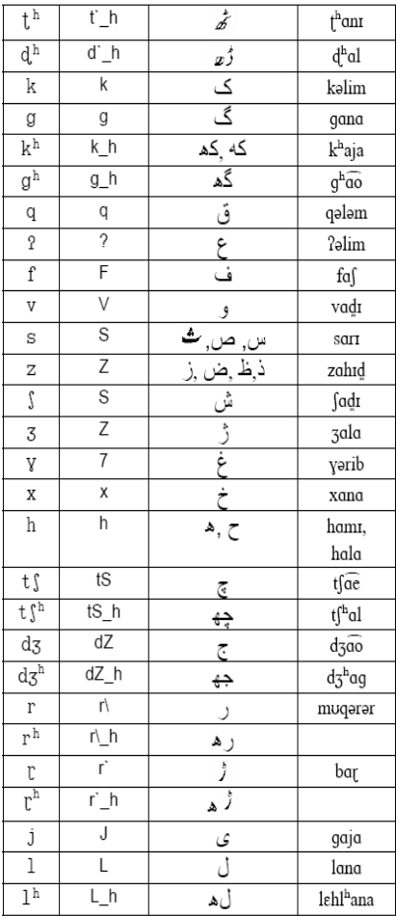
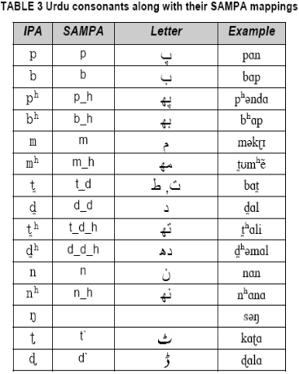
SAMPA –Urdu IPA in ASCII crulp-2002-speech assessment methods phonetic aphabet (sampa) analysis of urdu.pdf

Slide 6
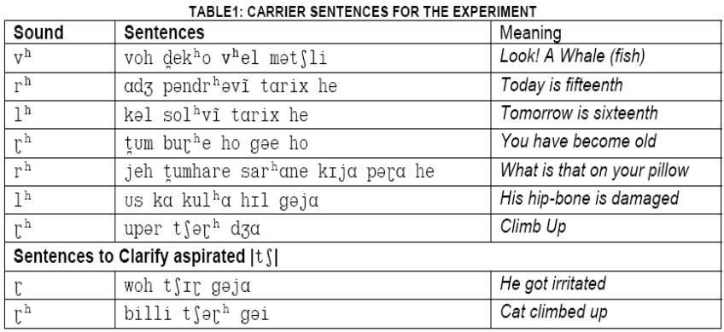
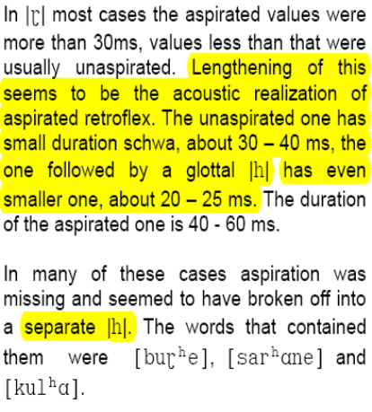
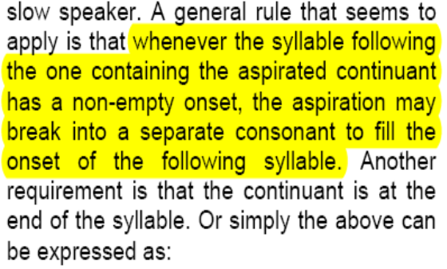
Laryngeal features in Urdu
Eliciting aspirated continuants crulp-2002-study of aspirated continuants in urdu.pdf
These sentences dont appear to be satisfactory for the intonation or stress (lenght of syllable prominence at least) or the following segment, sometimes a vowel, sometimes even an affricate!

Slide 7
Morphology

Slide 8
A family of morphology hypothesis B
Where are inflected forms made?
Chomsky 1970,
Marantz 1997
In the lexicon
In the syntax
?
?
Legate
to appear
Case
Feature
Functional
Head
Bayer et all 2001
PP
(KP)Bittner &
Hale 1996
Feature
Sharing/Percolation
?
KP
PlaceP
?
(PlaceP)
Svenonious 2006
Vuchic 1993
Frampton &
Gutmann 2006

Slide 9
What are syntactic “features”? nodes, or shared/percolation/project elements that are copied into bundles?
Syntactic structure?
Terminal nodes are feature bundles
Terminal nodes are features
DM + Fission
Nanosyntax
Spellout treelets
DM + Head movement:
spell out constituents
How are multiple realizations of features accounted for?
Terminal nodes are feature bundles
Terminal nodes are features
Features are different creatures from terminals,
so they can be percolated/projected
?

Slide 10
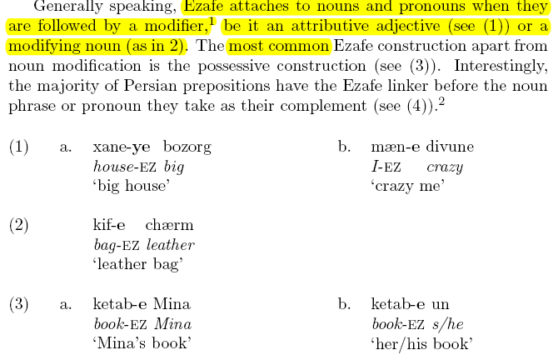
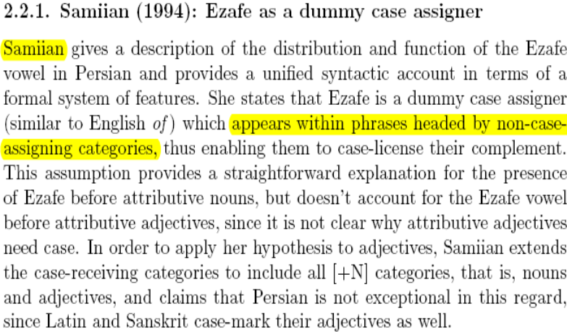
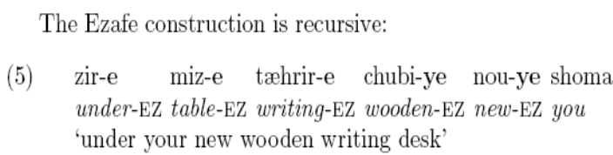
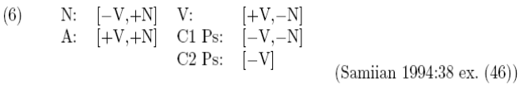
Persian vs hindi/urdu ezafe/oblique pantcheva-2006-persian prepositions classes.pdf cook2006-Hindi-Urdu gerund -na and its nounyness
Persian ezafe and hindi/urdu oblique /e/ look similar/historically related:
they are the same vowel.
e in persian is after every noun and adjective in a NP
e in hindi/urdu is after every noun and adjective in an NP that is a complement of a postposition.
There are two classes of postpositions in Persian, and in Hindi-Urdu, they appear similar in that in both languages some of the postpositions end in –e and are more nouny and some don’t end in –e and are more functional. This was not the crucial difference i used to distinguish them in Urdu however. I distinguished them based on whether their complement was in the genitive or not.

Slide 11
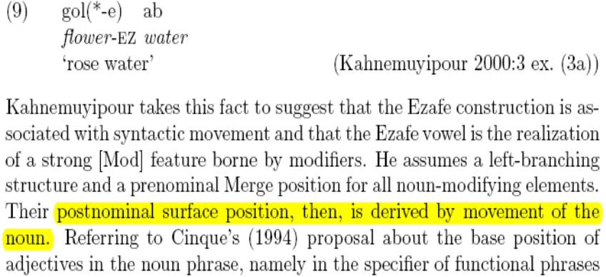
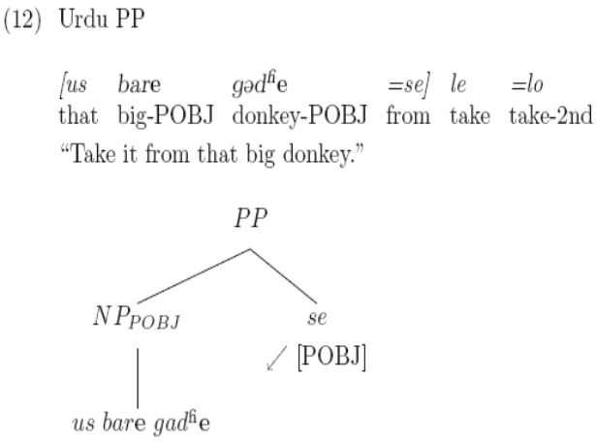
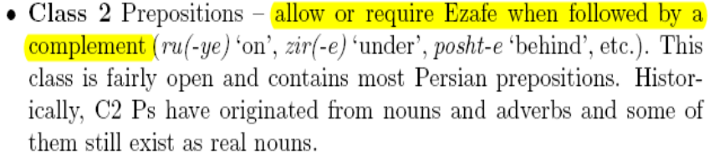

Slide 12
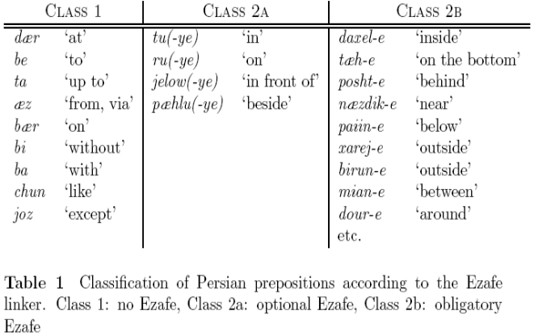
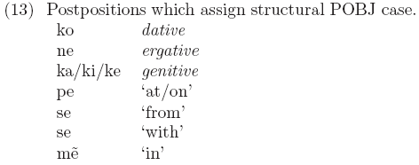
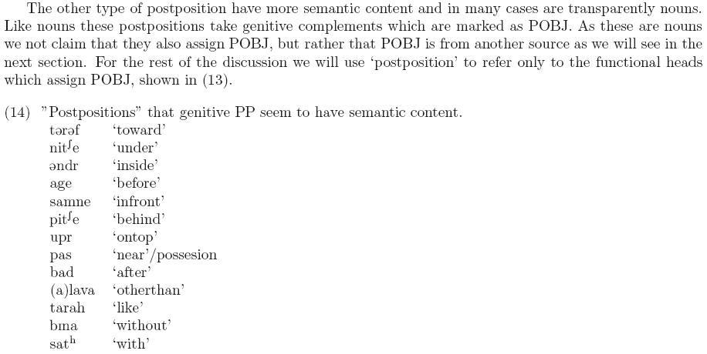
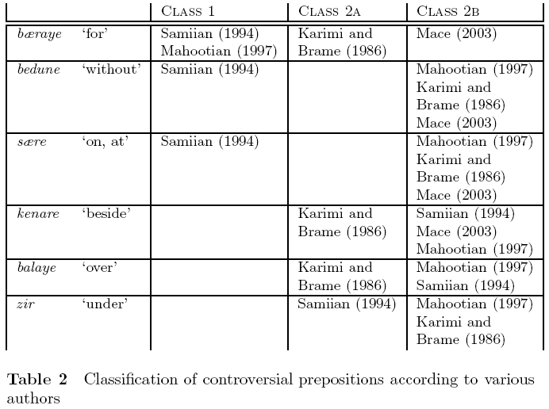
Persian vs hindi/urdu ezafe/oblique pantcheva-2006-persian prepositions classes.pdf cook2006-Hindi-Urdu gerund -na and its nounyness

Slide 13
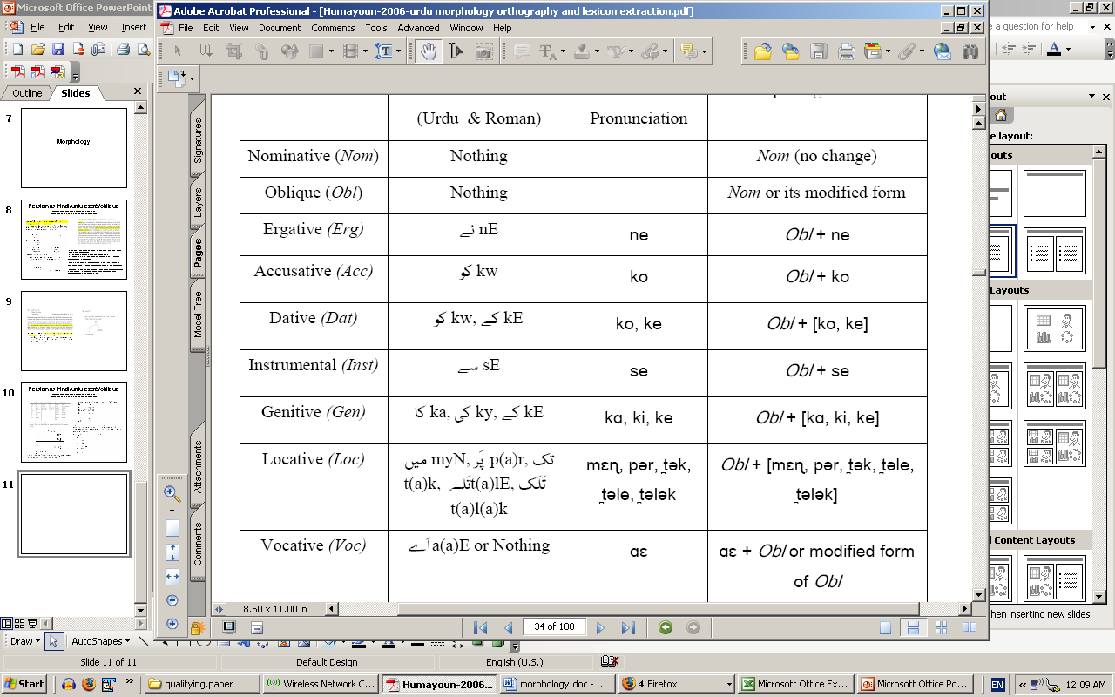
Humayoun-2006-urdu morphology orthography and lexicon extraction.pdf

Slide 14
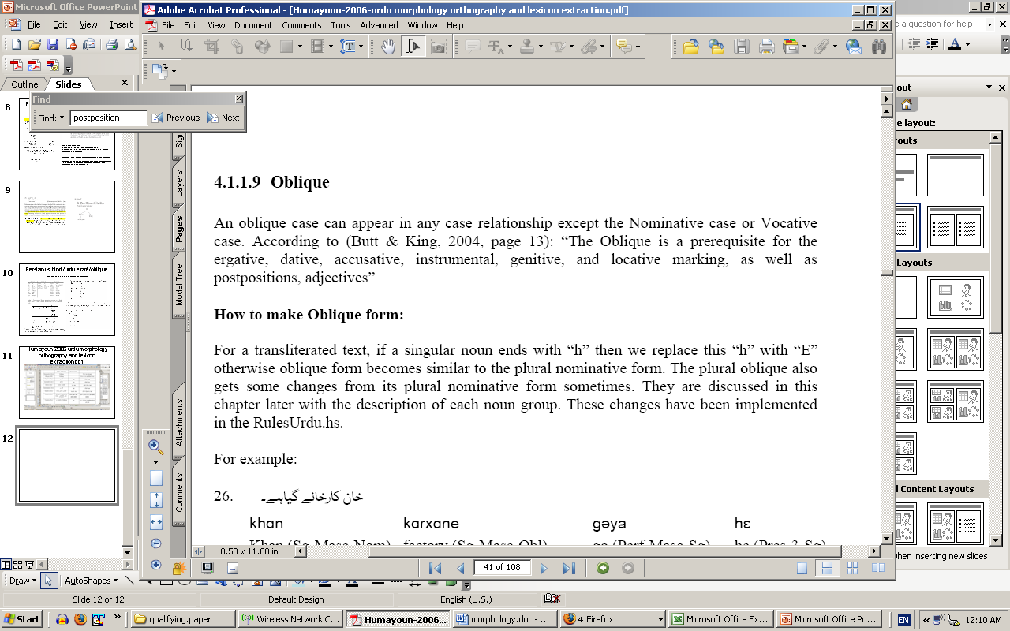

Slide 15
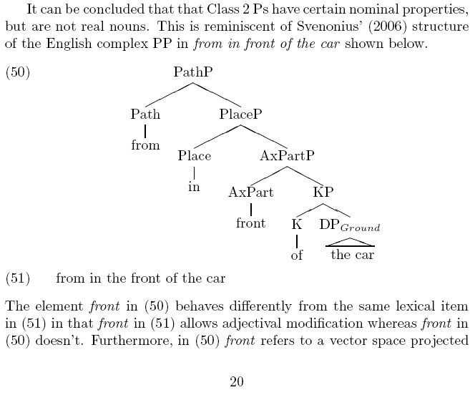

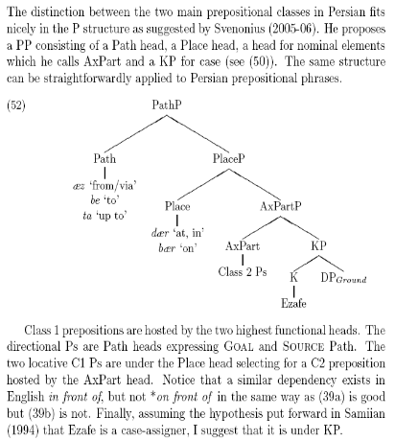
Syntax of PPs, pancheva 2006:20

Slide 16
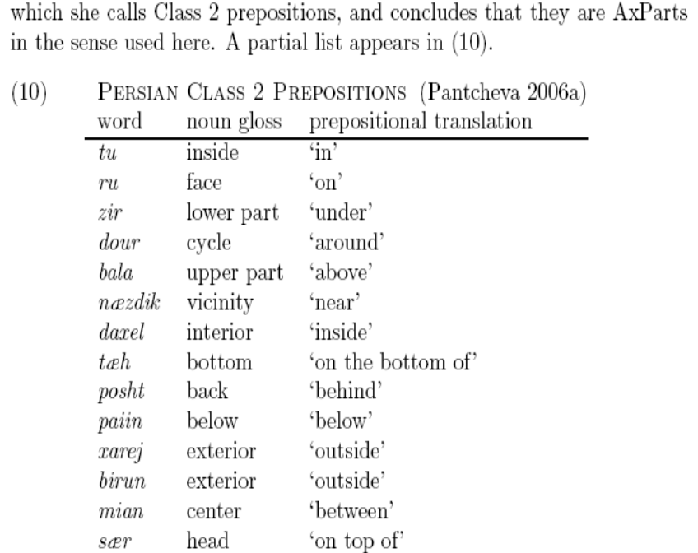
svenonius-2006-the emergance of axial parts.pdf
Words like `top’, `bottom’,`front’, `back’, `side’, `end’, `edge’, `hind’, `neath’, `tween’ have two uses the `N use’ (the front of x) in its ‘part’ sense and the `AxPart’ use (in front of x) as the spatial sense.
Svenonious (2006) argues for a projection which he calls Axpart for based on Jackendoff’s (1996) and Marr’s (1982) discussion of axial structures in spatial cognition.

Slide 17
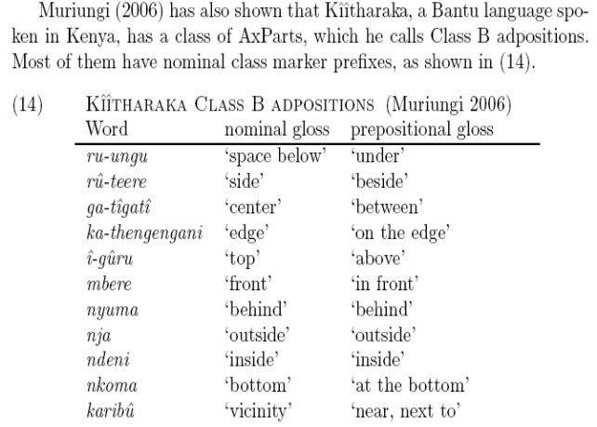
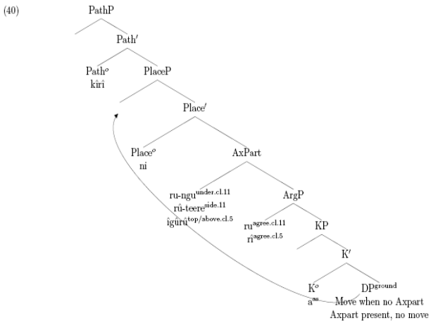
muriungi-2006-categorizing adpositions in Kiitharaka.pdf

Slide 18
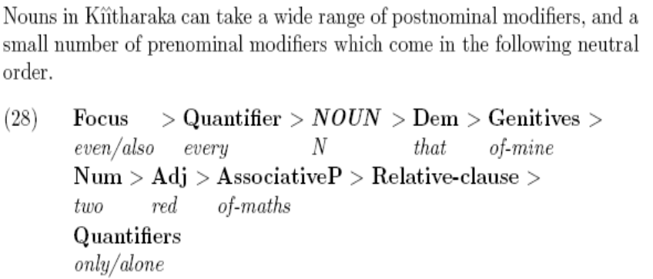
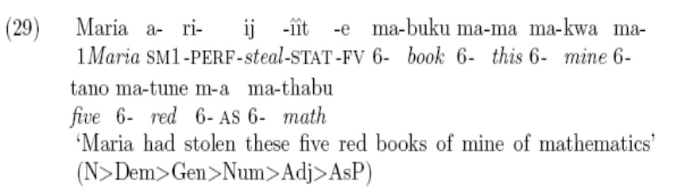
DP structure from peter’s paper
Urdu [mere har-ek lal-si mathmatek-i kitab hi ] le lia
Mary ne [mere panch lal-si mathmatik-i (ki?) kitaab hi] le lia

Slide 19
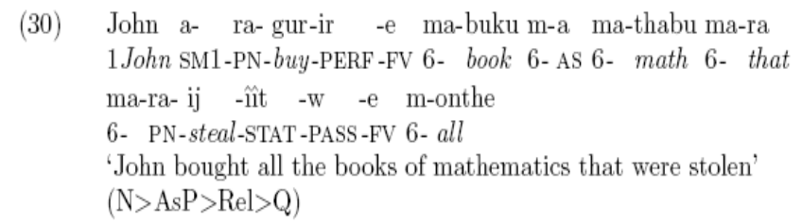
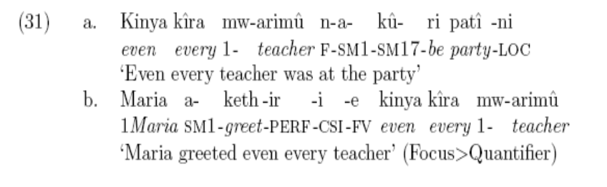
John kharide ga [us sare mathmatik-i kitaab jisne mary ne le lia]
Har bhi teacher party pe tha
Mary ne har bhi teacher ko salaam keh dia

Slide 20
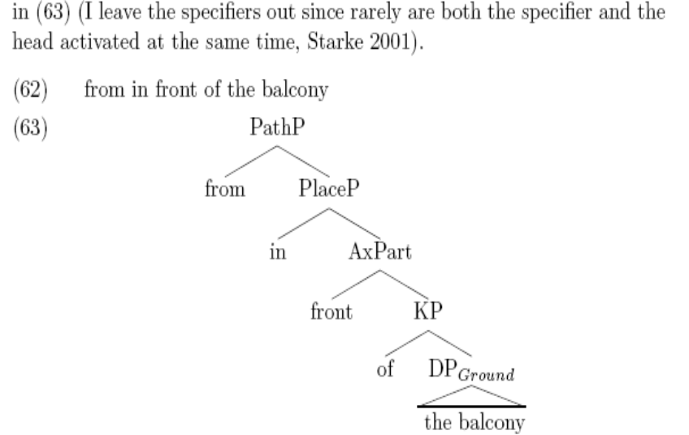

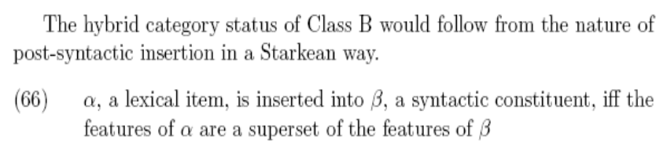
“Here I will assume along with Koopman (2000), den Dikken (2003), Svenonius (2004), and Svenonius (2005-6) that the structure of PPs is more articulated.” (Muriungi 2006)
His references:
Baker, Mark C. 1988. Incorporation: A Theory of Grammatical Function Changing. University of Chicago Press, Chicago.
Baker,Mark C. 2003. Verbs, Nouns, and Adjectives: Their Universal Grammar . No. 102 in Cambridge Studies in Linguistics. Cambridge University Press, Cambridge.
Carstens, Vicki. 1991. The Morphology and Syntax of Determiner Phrases in Kiswahili . Ph.D. thesis, UCLA.
den Dikken, Marcel. 2003. On the syntax of locative and directional adpositional phrases. Ms. CUNY.
Koopman, Hilda. 2000. Prepositions, postpositions, circumpositions, and particles. In The Syntax of Specifiers and Heads, edited by Hilda Koopman, pp. 204–260. Routledge, London.
Starke, Michal. 2001. Move Reduces to Merge: A Theory of Locality. Ph.D. thesis, University of Geneva. Available at http://ling.auf.net/lingBuzz/000002.
Svenonius, Peter. 2004. Spatial prepositions in English. Ms. University of Tromsø; available at http://ling.auf.net/lingBuzz/000001.
Svenonius, Peter. 2005-6. Moving right along. Seminar series on adpositions in Tromsø.

Slide 21
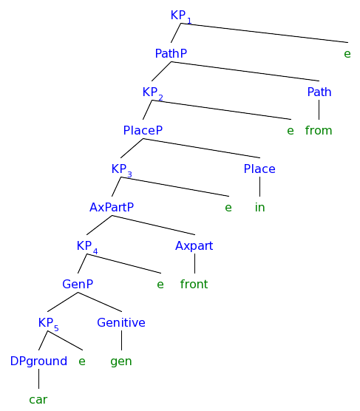
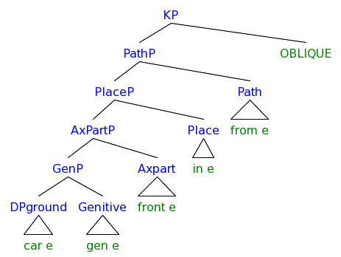
Syntax tree maker: http://www.yohasebe.com/rsyntaxtree/
Hypothesis 1 “syntactic/semantic”- all of the e are functional heads
[KP [PathP [KP [PlaceP [KP [AxPartP [KP [GenP [KP [DPground car ] e ] [Genitive gen ] ] e ] [Axpart front ] ] e ] [Place in ] ] e ][Path from ] ]e ]
Hypothesis 2 “morpho/syntactic”- all of the e are concord at spellout from the highest node being marked oblique
[KP [PathP [PlaceP [AxPartP [GenP [DPground car e] [Genitive gen e] ] [Axpart front e] ] [Place in e] ] [Path from e] ] OBLIQUE ]

Slide 22
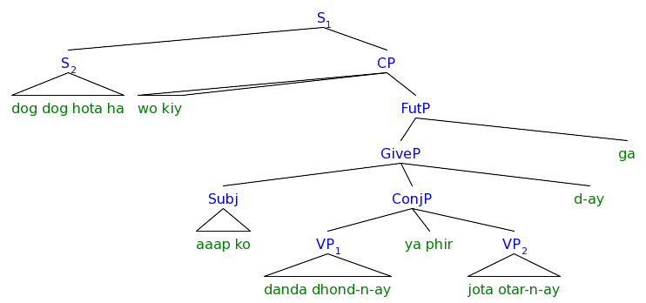
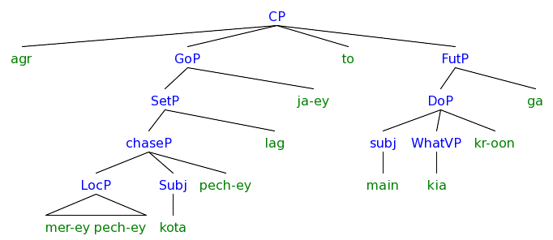
Examples of –e 060427aagar.aap.ke.pechey.3.1all.pdf
[S [S dog dog hota ha ] [CP wo kiy [FutP [GiveP [Subj aaap ko ] [ConjP [VP danda dhond-n-ay ] ya phir [VP jota otar-n-ay ] ] d-ay ] ga ] ] ]
Line 2
[CP agr [GoP [SetP [chaseP [LocP mer-ey pech-ey ][Subj kota ] pech-ey ] lag ] ja-ey ] to [FutP [DoP [subj main ][WhatVP kia ] kr-oon ] ga ] ]

Slide 23
Cleft: It was who that you saw?
Pseudo-Cleft: the one that you saw was who?
Wh-criterion: spec of CP must be filled when there is a +Q feature on C (?)

Slide 24
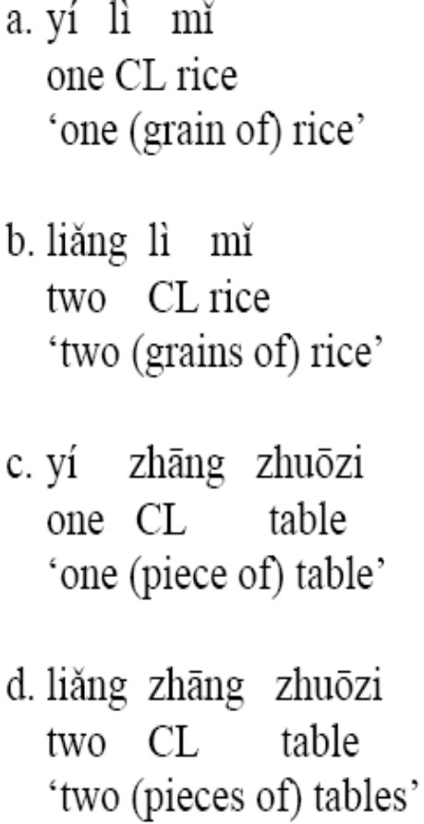
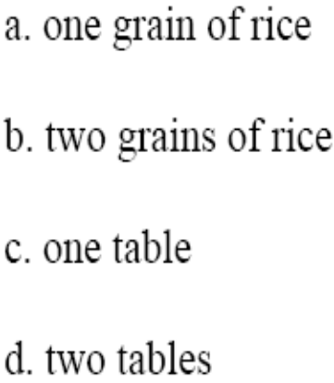

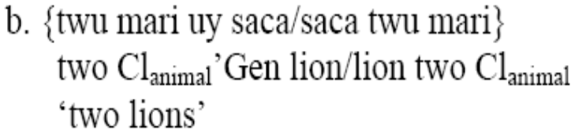
DPs kim-2005-the korean plural marker tul and its implications(diss).pdf
The Mass View (Chierchia 1998), all nouns in generalized classifier language (Chinese) are mass, so like mass nouns in English, if you want to count them you need a unit (classifier) and like mass nouns in English you can’t pluralize them.
My note: Notice that classifiers in English take GENITIVE complements, but not in Chinese. Does Chinese not have genitive available? What about in Japanese? In Korean they must take genitive.
  Situation A: Classifier languages have genitive available but don’t use it with classifier + N = would make Korean different from classifier languages.
  Situation B: Classifier languages with no genitive available and don't use it with classifier + N = wouldn't challenge Korean as a classifier language.

Slide 25
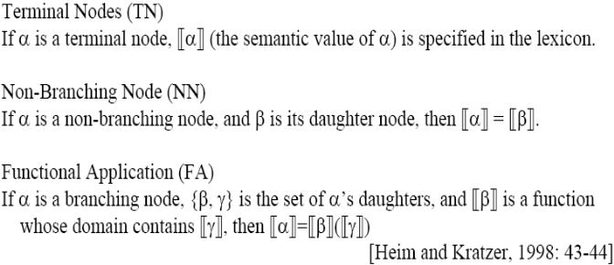
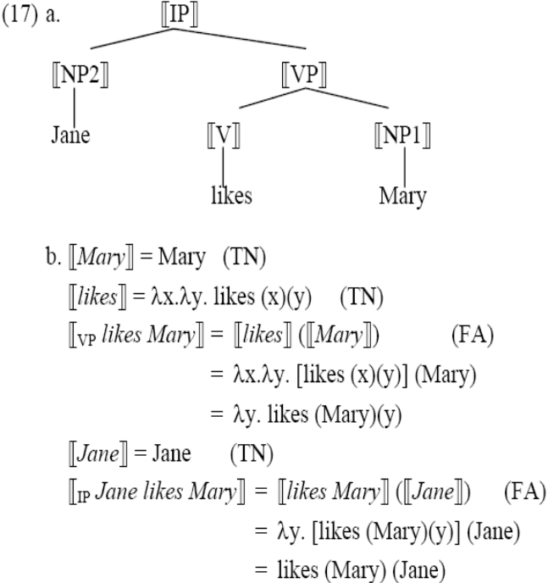
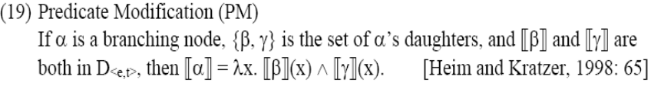
Semantic Framework kim-2005-the korean plural marker tul and its implications(diss).pdf
“The semantic assumptions of this thesis are embedded within the semantic system developed in Heim & Kratzer (1998). Most importantly, I follow the assumption that interpretation is compositional and type driven with a limited set of interpretation rules.” (Kim 2005:9)
““Type-driven” means that given two syntactic sisters A and B, they can only combine if they are of appropriate types. If they do not have appropriate types, a type mismatch arises, and the derivation fails unless some repairing mechanisms apply and save the derivation. Two types of repairing mechanisms are available in the literature: movement (with interpretation rules) and covert type shifting operations. Both mechanisms are compatible with the purpose of this thesis.

Slide 26
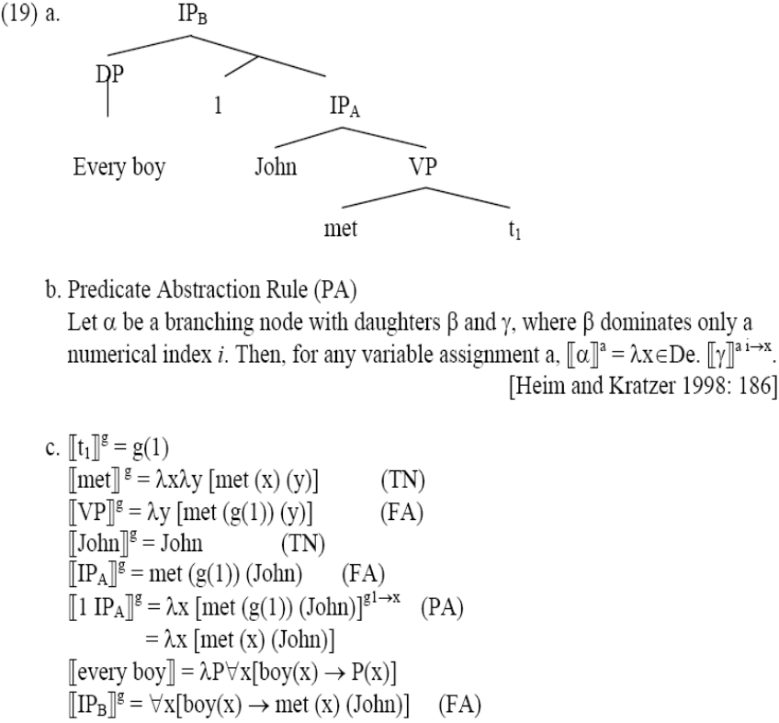

Type miss-matches can be resolved by predicate abstraction
“Another repairing mechanism for a type mismatch is a set of type shifting operations proposed by Partee and Rooth (1983) and their successors.”
Type shifting can be necessary (what’s the difference from a null functional head?):
  Korean NPs can serve as arguments, even though their type is <e,t> instead of <e>, so Kim uses a covert type shifter iota

Slide 27
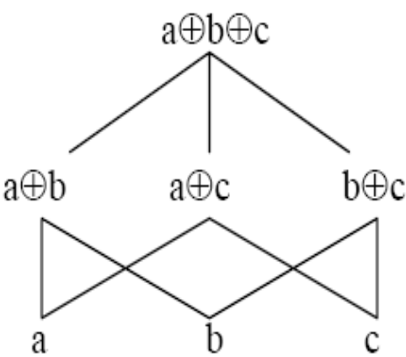
Plurality kim-2005-the korean plural marker tul and its implications(diss).pdf
“Link (1983) and Landman (1989, 1991), that our domain of quantification has an algebraic structure called join semi-lattice ... which is ordered by the part-of (≤) relation.”
  (For a detailed and clear introduction to join semi-lattice structure, see Ojeda (1993) and Doetjes (1997).)
a ≤ a⊕b
The elements at the bottom of the lattice are atoms or singularities.
The other elements are sums or pluralities.
In terms of sets:
The part-of relation can be the subset (⊆) and the join operation can be union (⋃)
a ⊆ (a ⋃ b)
Atoms can be singleton sets, and sums can be non-singleton sets.
Chierchia uses set terms.
There is a debate whether plural nouns include singularities.

Slide 28
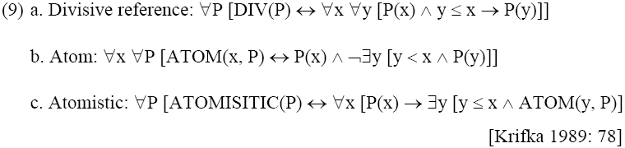
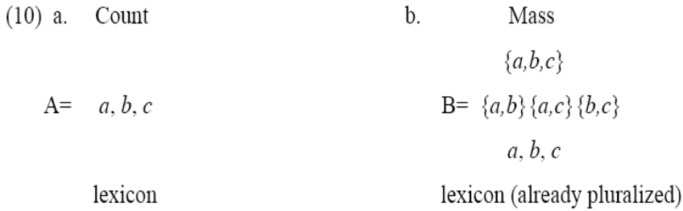
Mass vs Count kim-2005-the korean plural marker tul and its implications(diss).pdf
Mass nouns have divisive reference
  Half a cup of water is still water
Count nouns have atoms in their extensions.
  There are minimal individuals table which don’t have table as their subparts
Since count/mass are defined by meaning, and the meaning of objects is the same crosslinguistically, all languages should have a count/mass distinction.
But furniture is lexically mass, yet its not divisive and it clearly has atomic parts in its denotation.
Count/Mass for Chierchia:
If it denotes a singular its count (10a), if it can denote either a singular or a plural its mass (10b).

